Slide 1


https://www.jiujitsutimes.com/goal-setting-for-2015/

Slide 2
Features vs Benefits
Feature- a fact about the product or service being promoted.
This is not what entices customers to buy.
Benefit answers the question "What's in it for me?,“
Tell the customer what benefit they will gain from having the feature
http://owners.honda.com/vehicles/information/2017/Odyssey

Slide 3

Career Action Plan
What is your ultimate career goal?
https://www.youtube.com/watch?v=2H6uJT16FtE
Notes:
In class activity. Watch video.

Slide 4
Action Plan
An effective action plan should give you a concrete timetable and a set of clearly defined steps to help you achieve your objective.
Helps you focus your ideas and provides you with an answer to “what do I do to achieve my objective?”
Where am I now?
Where are you in terms of education, skills and experience as it pertains to your program or field of study? What is the larger scope of where you are? Be specific.
Where do I want to be?
Where do you want to be at the beginning of your co-op term? Here you want to include the type of role and type of company you wish to work for. What requirements do you need? What skills and experience are these positions asking for?
How do I get there?
SMART goals, SMART objectives.
Take Action
Review the plan

Slide 5
Co-op Work Term Action Plan
End Point/Goal for Co-op Work Term
Goals & Objectives
Strategic Planning (timeline)
Evaluation/Accountability

Slide 6
Identify your end point/ultimate goal (co-op work term)
The most effective way to begin with the end in mind is to develop an end point/ultimate goal.
Develop an Ultimate Goal (for your co-op work term), one that focuses what you want to be in terms of character and what you want to do in reference to contribution of achievements.
Stephen Covey

Slide 7
Set S.M.A.R.T. Goals
You build your future by developing concrete plans to reflect your priorities
These become your goals for the next year
It is important that you develop focused goals
Specific
Measurable
Achievable
Realistic
Time Stamped
Notes:
7
Many people do not routinely set goals for themselves. In fact, most people report that they “FELL” into their jobs. Goals are like train rails. They keep us on tack. They allow us to stay focused while moving forward.

Slide 8
Specific
Goals need to be clearly stated so they are easily understood and easy to remember.
Define whether the goal is short term or a long term goal.
short term is immediate to one year
long term will be two to three years
Consider the who, what, where, when, why and how?

Slide 9
Measurable
The only way to know whether you accomplished your goals is if you have some way to measure it.
Use numbers, if possible, to evaluate your progress.
i.e. I will send out 25 resumes within six months.
Is this a SMART goal?
Notes:
On average, you will send out 80 resumes while looking for your co-op.

Slide 10
Achievable
Is your goal achievable in the allotted time
Impossible goals guarantees failure and low morale
What steps must you take in order to achieve your goal?
Consider the resources needed for the goal.

Slide 11
Realistic
Be realistic about how long it will take to reach your goal and the steps required to get there
Ensure your goal is both realistic and relevant to your end point.

Slide 12
Time Stamped
Without a defined deadline or time frame, it is too easy to procrastinate
Have a set time limit for each of your goals
To gain 15lbs of muscle (#gainz) by December 1st, 2018

Slide 13
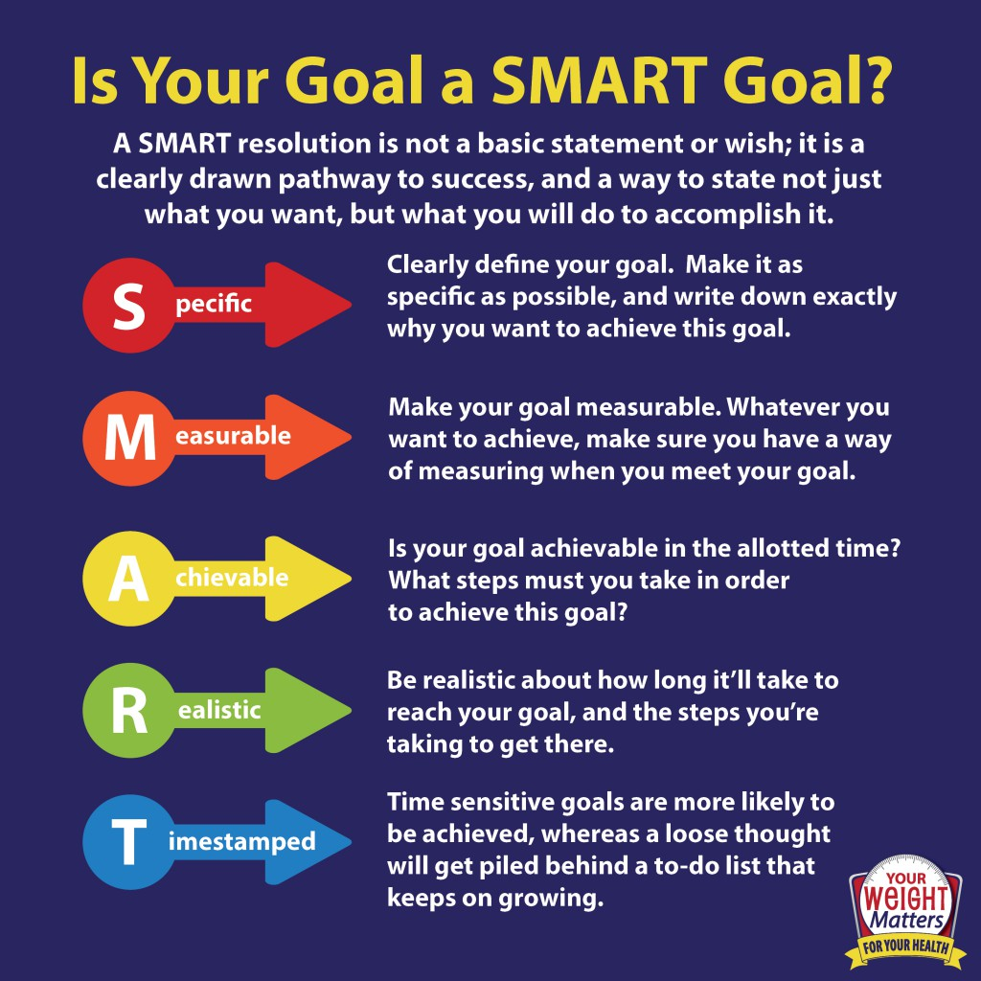
http://anaidza.com/what-is-a-smart-goal-acronym-smart-goals#forward

Slide 14
End point, SMART goal and objective example
End point: Decrease blood pressure to normal range (120 over 80), lose 10lb of fat and gain 15lb of muscle by Dec 31st 2018
S.M.A.R.T. GOAL: To gain 15lbs of muscle (#gainz) by December 1st, 2018
S.M.A.R.T Objectives:
Research at least 3 gym memberships and compare price, location and classes then sign up by March 1st, 2018
Create a new workout program (workout 3x a week) once a month for the next ten months until Nov 1st, 2018
Grocery shop once a week to create meal prep (3meals a day for 5days/week) for next ten months until Nov 1, 2018

Slide 15
Strategic Planning
Outline strategic steps to achieve goals and objectives in logical sequence using a P.E.R.T.
Start with your ultimate career objective or goal and work backwards (start with the end in mind)

Slide 16
Strategic Planning – TimeLine
Create from your timeline chart a critical path that you can reference
Establish timelines (weekly, monthly) for each item on your chart
Results, check-off results, reward yourself when one of your defined goals or objectives is reached

Slide 17
Create a Timeline
Where you are now
Goal 1
Goal 2
Goal 3
Mission Statement
Where am I now?
Where do I want to be?
How will I get there?

Slide 18
Implementation – follow-up
Present this completed document to someone who will be an accountability partner with you help you evaluate and attain your goals
On your finished document you will, determine what this accountability structure will look like and establish a timeline for the accountability follow ups (ie. Once a week, once a month, etc)
Have your accountability partner sign the bottom of that page indicating that he/she agrees to partner with you in helping you attain your future goals

Slide 19
Goal Setting Worksheet Assignment
Where are you now?
Ultimate Goal (End Point) – Where do you want to be? (beginning of your co-op work term)
How will you get there?
Today Co-op Work Term

Slide 20
Week #2 - Online Work
Research Why 3% of Harvard MBA grads made 10 times more than their classmates.
Watch - How to Find and Do Work You Love
https://www.youtube.com/watch?v=jpe-LKn-4gM
Answer – Why is goal setting important to a successful job search? 250 words

